Slide 1
Social Networking Sites Automation Using Selenium
Group Memebers:
Rahul tadavi Project Guide:
Mohammmed udaipurwala mr. Vivek kadam Sir
Pramod gaikwad

Slide 2
Introduction
Selenium is a robust set of tools that supports rapid development of test automation for web-based applications which we open in different web browser like google chrome, firefox, internet explorer and etc.
Selenium is a combination of tools for functional tests, smoke tests, and integration tests of Web applications, including Rich Internet Applications (RIA, using Ajax.).
In this project we used python for automation of social sites through the selenium web-driver that is a bridge the gap between GUI application and web application.
This paper work will show how tests are created to automate a web application, which in the case of study we have received Facebook's web application.

Slide 3
WHY SELENIUM?
Cross Platform and Browser Compatibility.
The beauty of doing these scripts in Selenium is that you could run these scripts after they are just written and see instantly where they may need tweaking and amending.
Flexibility and Extensibility: Selenium’s strongest characteristic when compared with proprietary test automation tools and other open source solutions. Selenium-RC supports multiple programming and scripting languages.
Portability: Allows to record scripts in Windows and replay it in Linux without re-creating the script.

Slide 4
WHY PYTHON IS USED FOR AUTOMATION?
Python is an interpreted high-level general purpose programming language. Python's design philosophy emphasizes code readability with its notable use of significant indentation.
In comparison to other programming languages that can be used for Selenium test automation, Python contains less verbosity and is relatively easy to use.
It is easy to learn programming language that allows organizations to script custom automation and reap the time-savings with selenium web-driver that directly connects to the web application.

Slide 5
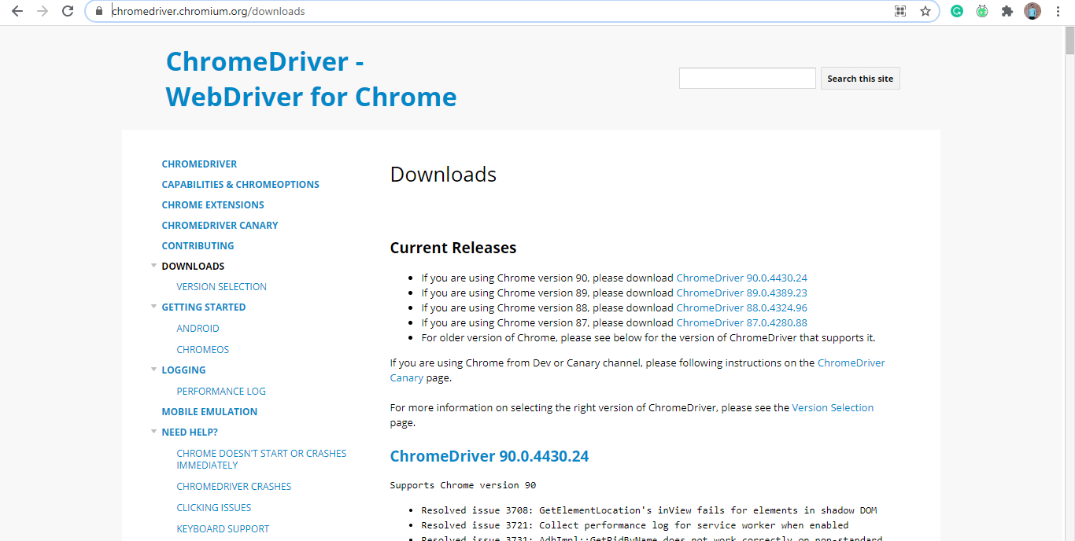
Working process
Step 1:- First we need to install chromium web-driver for connecting GUI application to web application using this download link
https://chromedriver.chromium.org/downloads

Slide 6
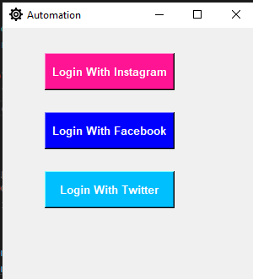
Step 2:- Visit main automation option GUI page for automation of any social pages like Facebook, Instagram, and Twitter.

Slide 7
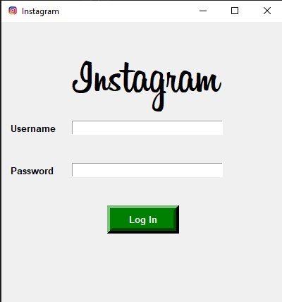
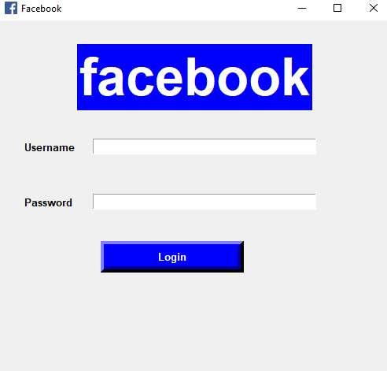
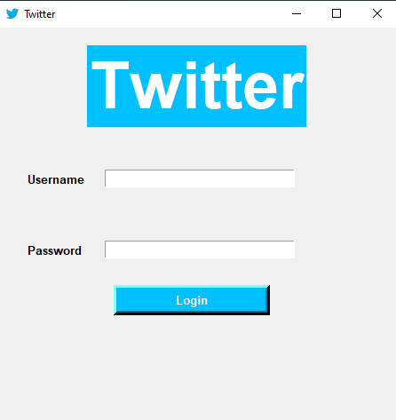
Step 3:- After the main page we visited 3 Login pages for login in various social sites account like Facebook, Instagram, and twitter, etc. Enter the username and password Login it.

Slide 8
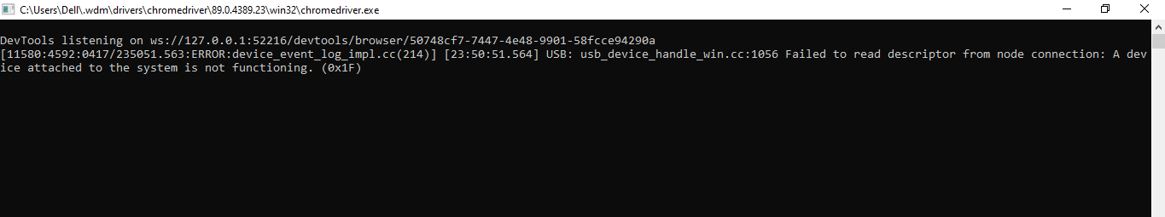
Step 4:- Chromium driver reads the data and connects the GUI application to web base application and the record store on the MySQL database. It is an bridge the gap between GUI application or scripting application to web application.

Slide 9
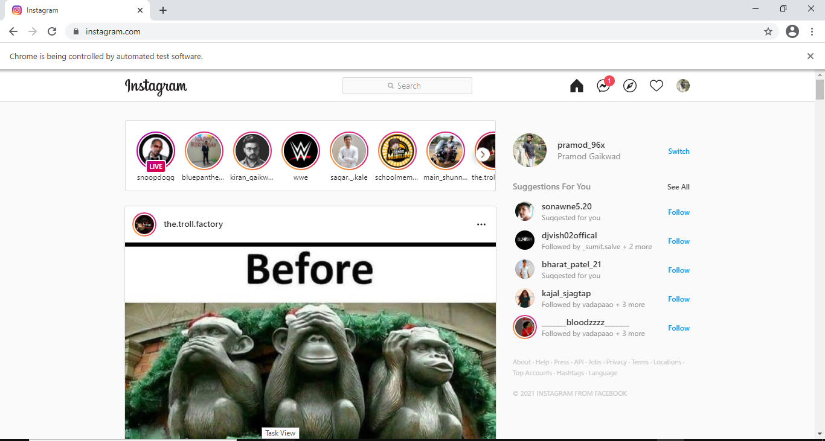
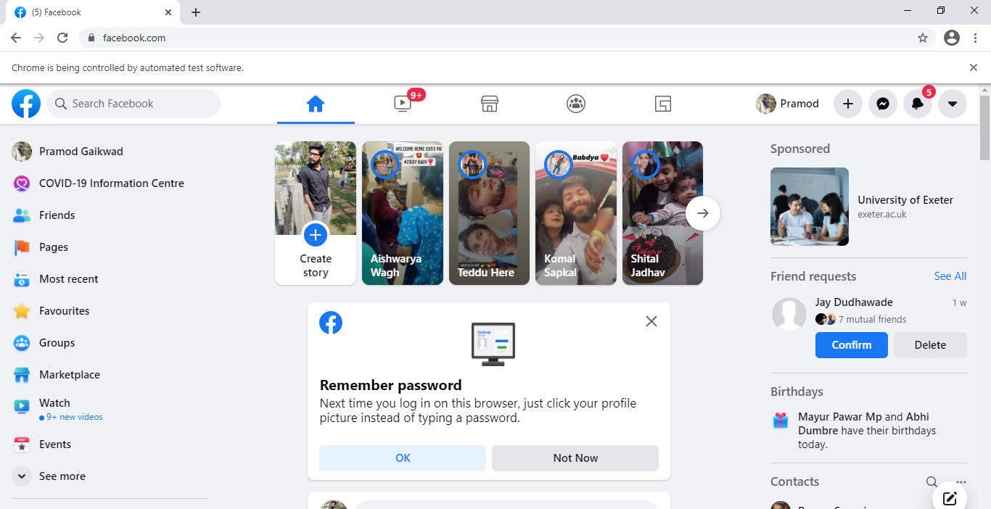
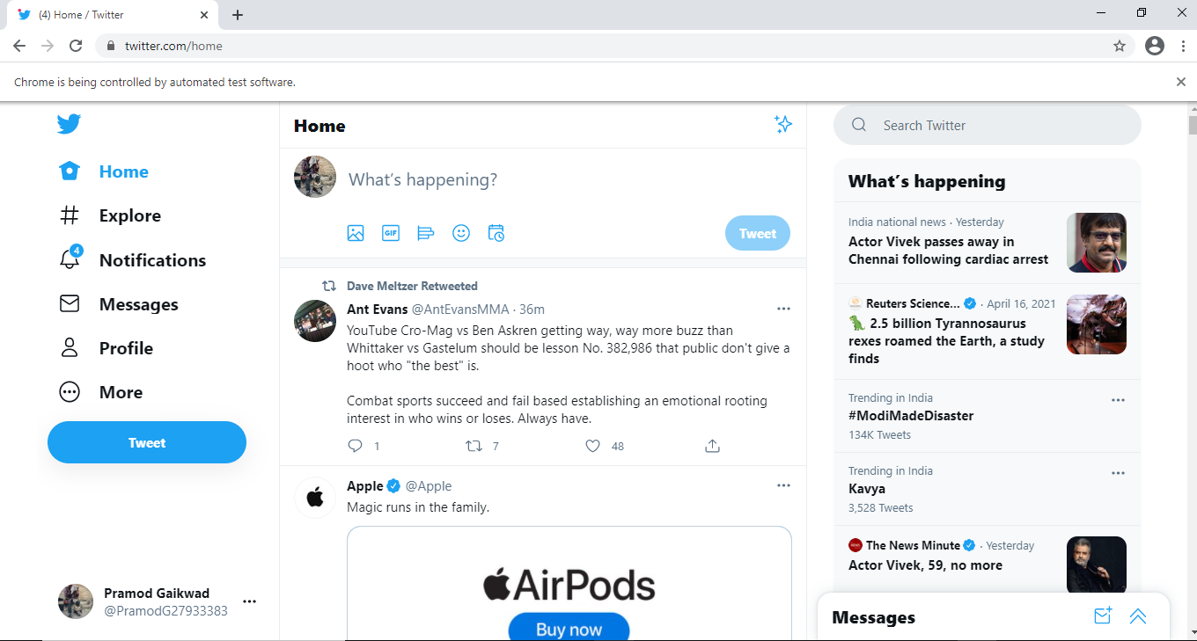
Step 5:- After username, password entered and chromium web-driver reads the data the result will show onto the different web applications.

Slide 10
Algorithms step for complete result
Create different GUI windows for different login pages .
Create username and password GUI page for different sites automation.
If username and password not entered then it will show error message in a web application.
In other part we have to create selenium web driver for connecting GUI application and web application.
Create x-path for username, password and login content.
Enter your registered username and password on GUI page and submit it.
The selenium web driver reads the data and connects to the web application.
The result shows onto the web application.

Slide 11
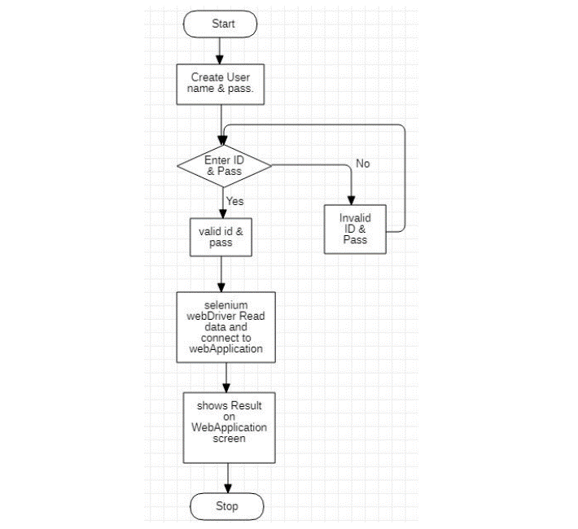
FLOWCHART

Slide 12
Advantages
Language and Framework Support.
Open Source Availability.
Multi Brower Support.
Support Across Various Operating System.

Slide 13
Requirements:-
Software Requirements:-
Windows 10 or various
Visual Studio Code
Python 3.7
MySQL Workbench
Google Chrome
Hardware Requirements:-
Processor – Core i3
Hard disk – 1TB
Memory – 6GB RAM

Slide 14
Future scope
As web applications are considered to be the next big thing for many companies worldwide, test automation market trends are steadily rising up with extensive demand with Selenium. Many top organizations across the world rely on Selenium resources for their test automation needs.
Conclusion
Selenium Automation has been considered by enterprises for multiple benefits, and most importantly to meet the objectives of Test Automation. The framework helps make the software testing process robust, cost-effective, and helps pace up the market.

Slide 15
THANK YOU

